Slide 1
Iibsashada/Iska diiwaangelinta iyo Gelitaanka Fasal

Slide 2


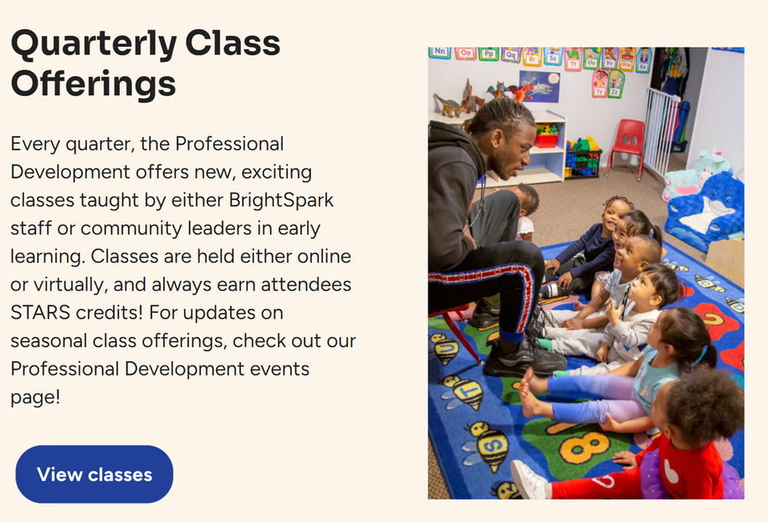

Qaybta Koobaad: Helida Fasalo
1. Booqo www.brightspark.org/professional-development.
Riix “Tababarada La Bixiyo (Trainings Offered).”
2. Qaybta hoose ee “Tababarada La Bixiyo (Trainings Offered)”, riix “Eeg fasalada (View classes).”

Slide 3
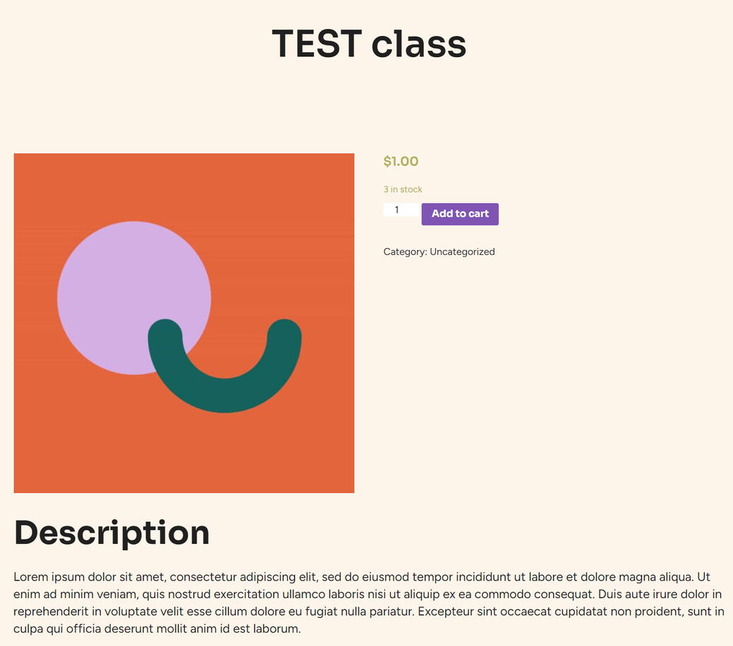
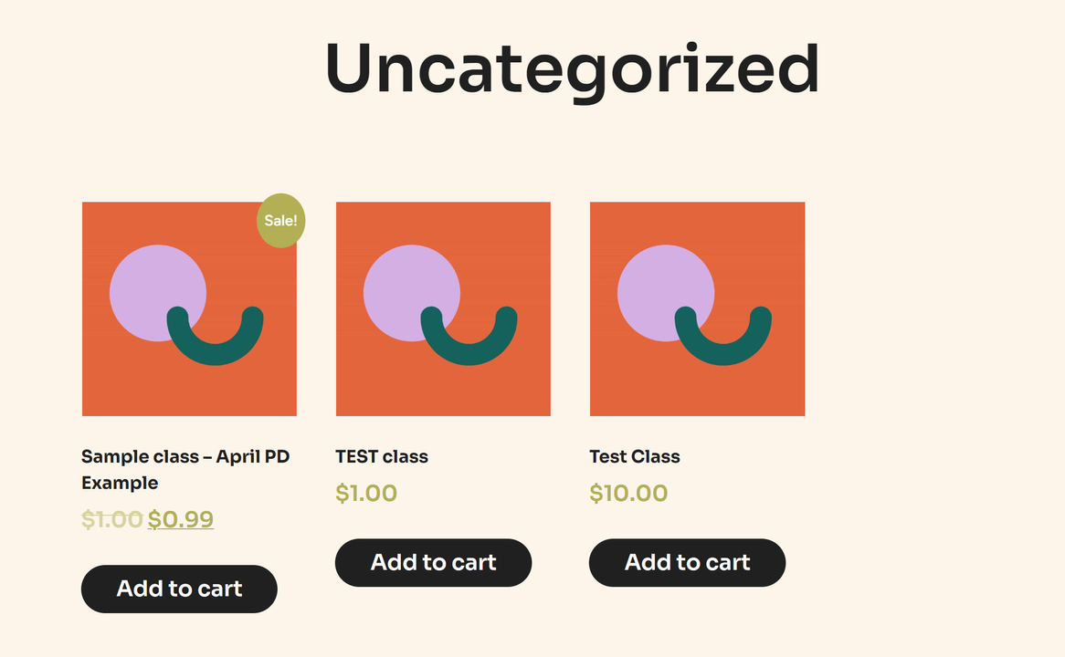
3. Markaas kadib waxaa laguu gudbin doonaa bog websaytka oo muujinaya fasalada hadda la iska diiwaangelin karo.
Haddii aad markaas ogaato fasal aad
danaynayso, waxaad riixi kartaa “Ku dar
Danbiishayda (Add to Cart)” ee qaybta
midig ee liistada.
4. Haddii aad doonayso inaad wax badan ka ogaato fasalka kahor inta aadan iibsan, riix sawir si aad boga fasalka ee hordhaca ah u furto.
Haddii aad go'aansato inaad qaadato fasalka, riix “Ku Dar Dambiishayda (Add to Cart)” ku jirta bogan.
4
3

Slide 4
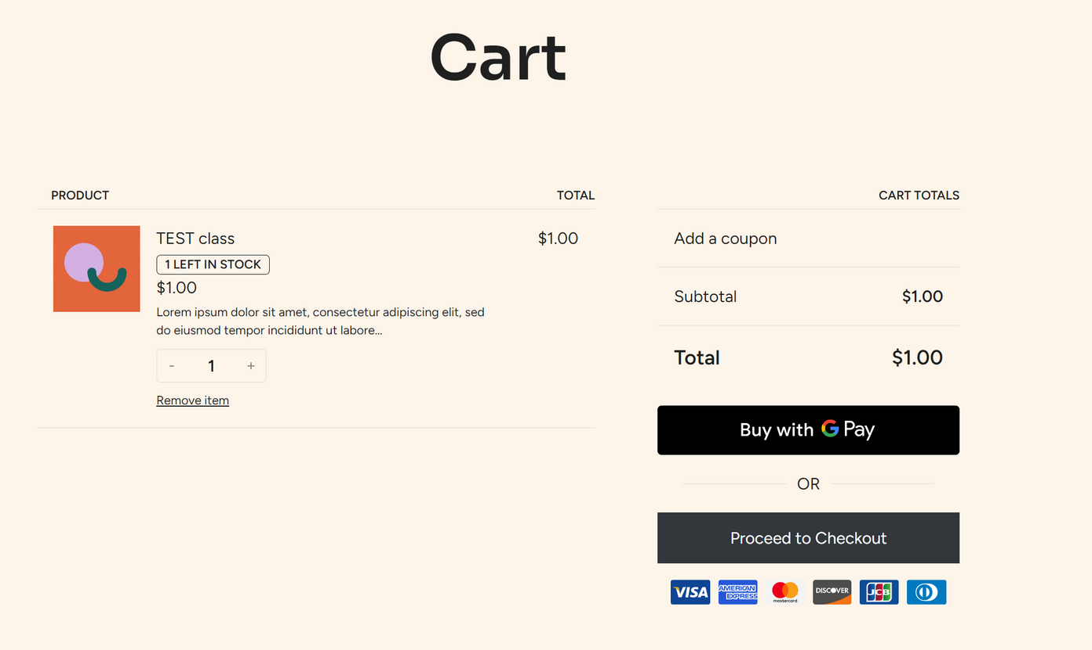
Qaybta Labaad: Iibsashada Fasal
1. Marka aad diyaarka u tahay inaad iibsato, riix astaanta danbiisa ee qaybta kore ee dhinaca midig. Kadibna, riix “Sii Wad Iibsashada (Proceed to Checkout).”
Tilmaan: Halkan ku dar koodh qiimo-dhimis!

Slide 5
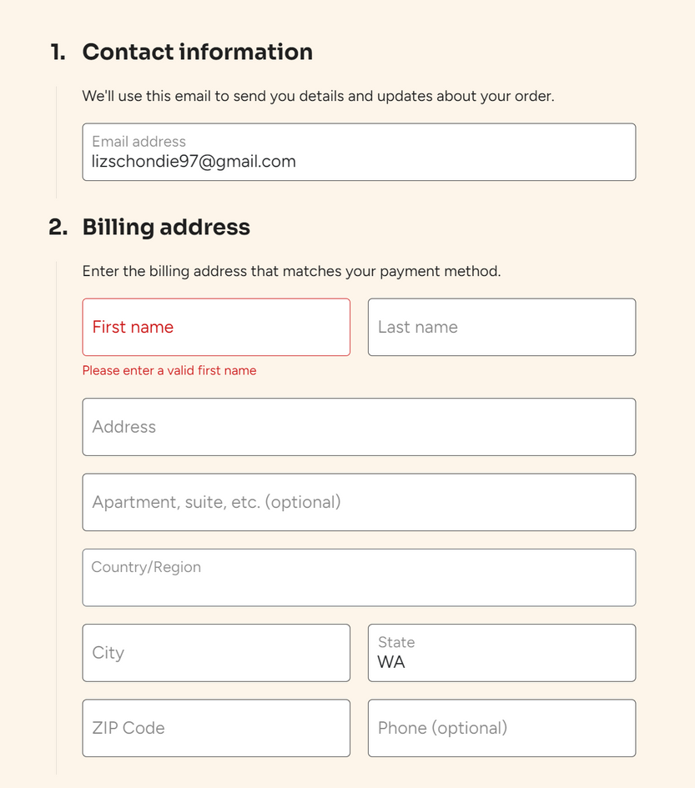
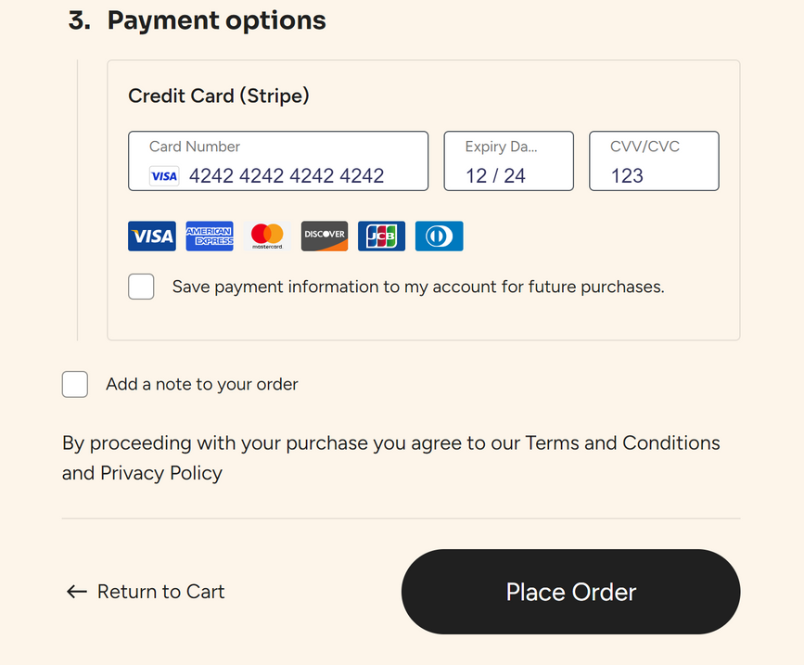
3) Foomka ku buuxi macluumaadkaaga xiriirka hadda, ciwaanka deegaanka ee biilka laga jarayo, macluumaadka lacag bixinta*, kadibna riix “Dalbo (Place Order).”

Slide 6
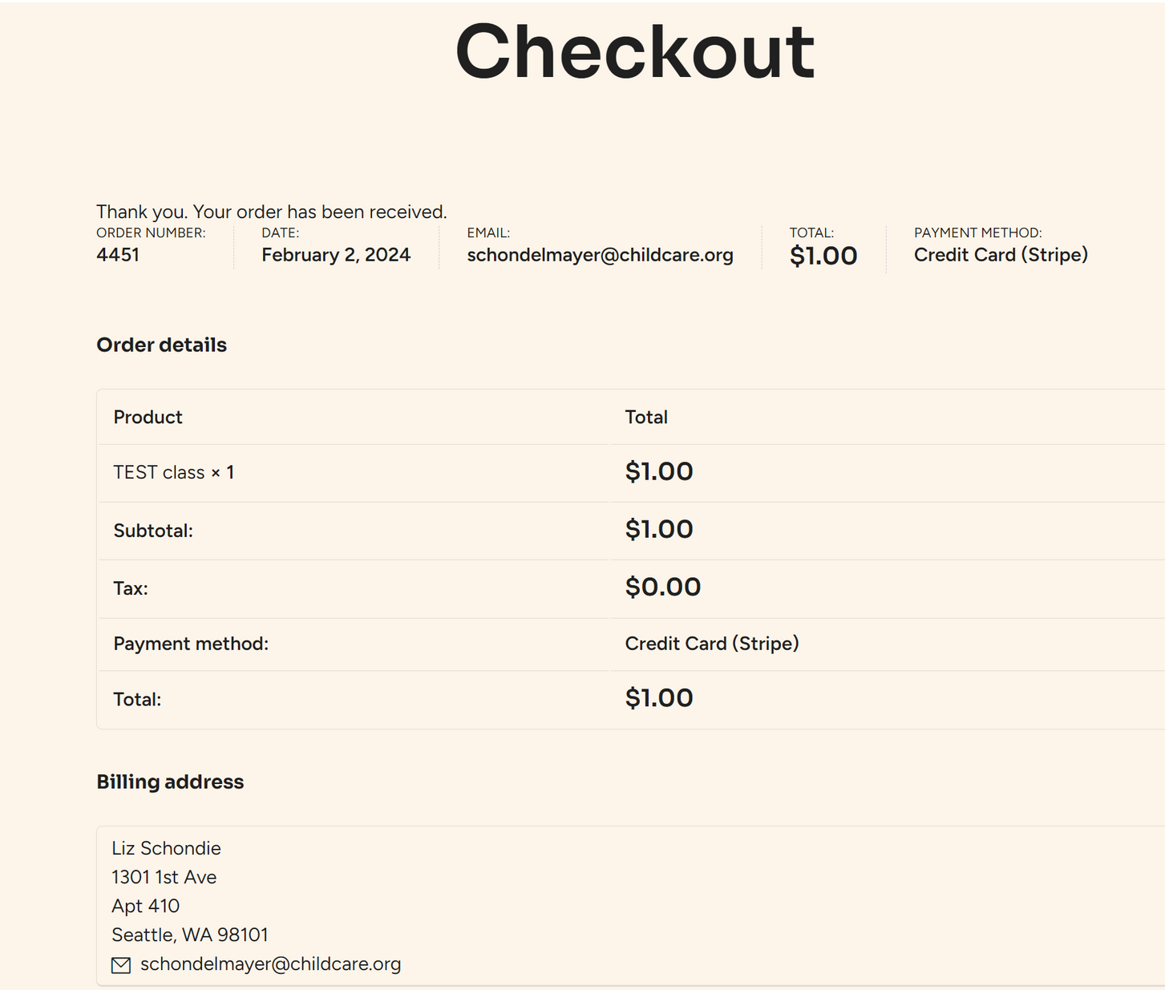
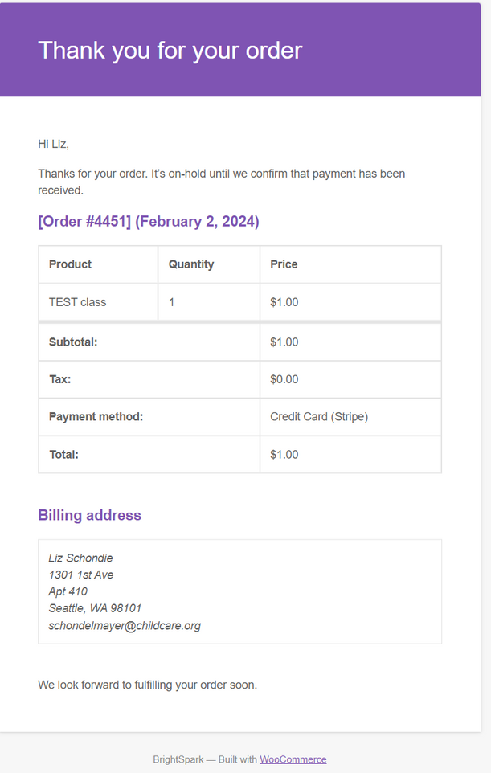
Marka aad fasal si guul leh u iibsato, waxaa laguu gudbin doonaa bogan. (Tilmaan: Waxaad ka qaadan kartaa sawir waxaadna kaydsan kartaa bogan si aad mustaqbalka u tixraacdo.)
Sidoo kale waxaad heli doontaa iimayl xaqiijinata iibsashadaada oo aad ku helayso koontada aad ku gashay WordPress ka. Iimaylku wuxuu ka imaan doonaa BrightSpark, wuxuuna lahaan doonaa ciwaanka “Dalabkaaga BrightSpark waa la helay (Your BrightSpark order has been recieved).” Waxa soo baxaaya sidaan ayay u muuqan doonaan:

Slide 7
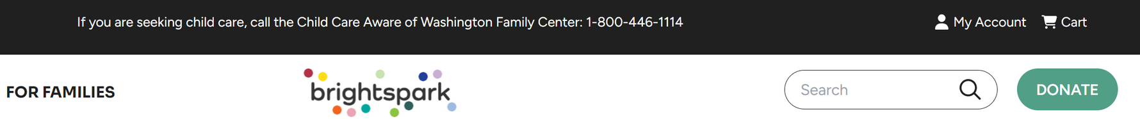
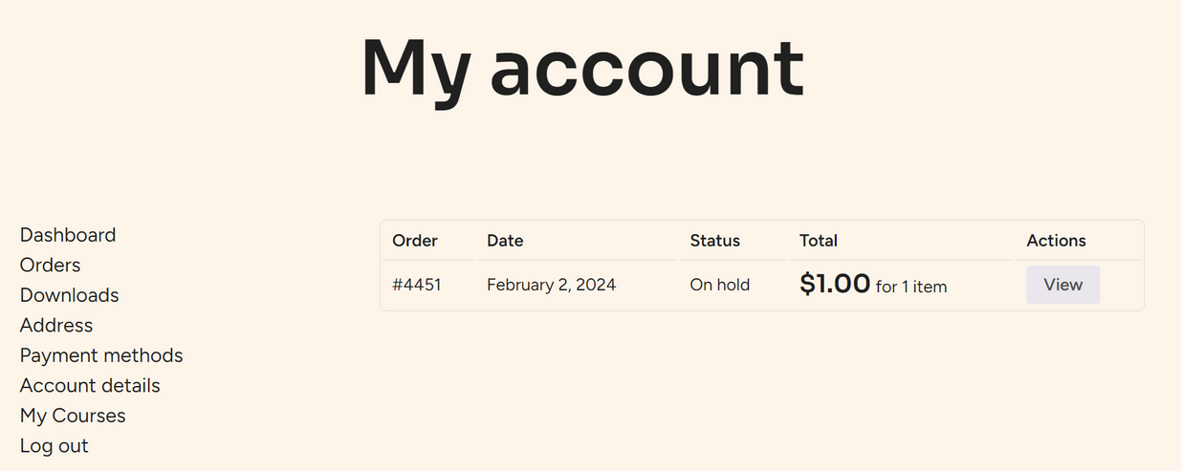
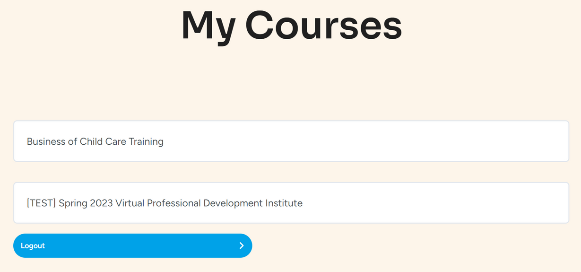

Waxaad cadeynta iibsashada ka heli kartaa qaybta ka hooseysa macluumadka koontadaada sidoo kale.
Gal qaybta kore ee boga, oo riix astaanta qofka ay ku qoran tahay “Koontadayda (My account).”
Kadibna, dooro “Dalabyada (Orders)” ku yaala dhinaca bidix ee liistada.
Kadibna, riix “Koorsooyinkayga (My Courses)” si aad u aragto koorsooyinkii kore aadna u gasho koorsooyinka cusub/hadda.

Slide 8
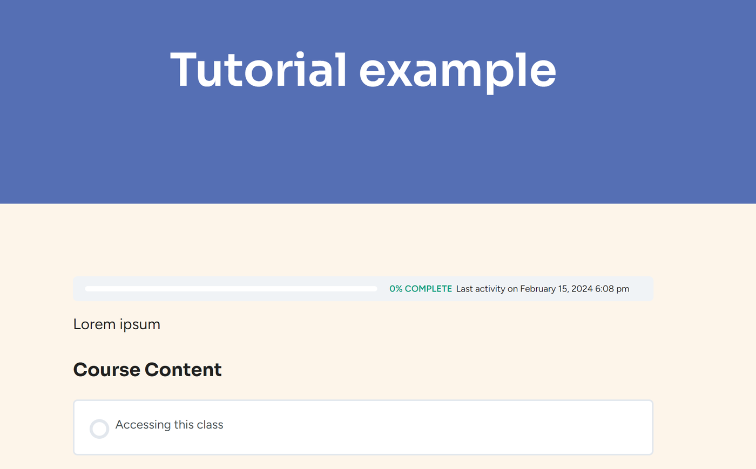
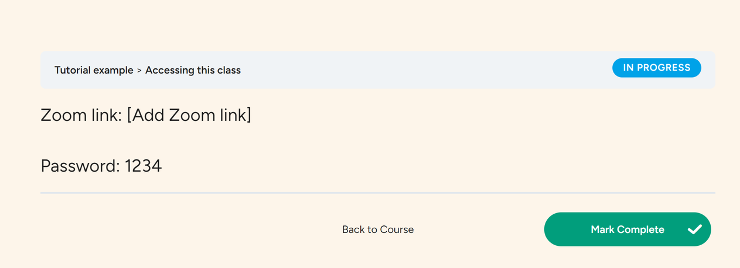
4. Marka aad diyaarka u tahay inaad gasho koorsooyinkaaga, riix ikhtiyaarada “Koorsooyinkayga (My Courses)”. Waxaa laguu gudbinayaa bogan:
Kadibna, riix “Helitaanka fasalkaan (Accessing this class).” Waxaa laguu gudbin doonaa bogga Casharka oo leh lifaaqyo kugu hagaya kulankaaga Zoom-ka.

