Slide 1
Welcome to the BrightSpark Professional Development Institute 24
May 13 – 17 Virtual via Zoom
May 18 In-Person, Renton, WA
Updated 4.24.24

Slide 2
Welcome to PDI – we hope you find this useful.
General Information
Quick Links to Flyers, ETC
How to register for PDI24 Virtual Sessions
How to register for PDI24 In Person
Requesting Interpretation

Slide 3
Who is PDI for?
YOU!
Pre-licensed or pre-service providers
Teachers, assistants, leads, caregivers
Directors, administrators, aspiring directors
Family, Friend and Neighbor caregivers
Early Head start, Head Start, ECEAP
Community based organizations,
Outdoor Nature Based staff
Staff at Part-Day preschool programs
School Age Staff

Slide 4
Flyers for the Professional Development Institute
Links to Flyers in
Arabic https://www.brightspark.org/wp-content/uploads/2024/04/PDI-Arabic-WEB.pdf
English: https://www.brightspark.org/wp-content/uploads/2024/04/PDI-English-WEB.pdf
Somali: https://www.brightspark.org/wp-content/uploads/2024/04/PDI-Somali-WEB.pdf
Spanish https://www.brightspark.org/wp-content/uploads/2024/04/PDI-Spanish-WEB-1.pdf

Slide 5
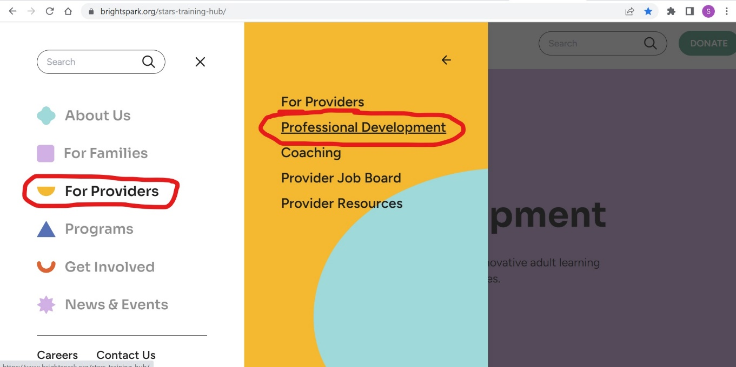
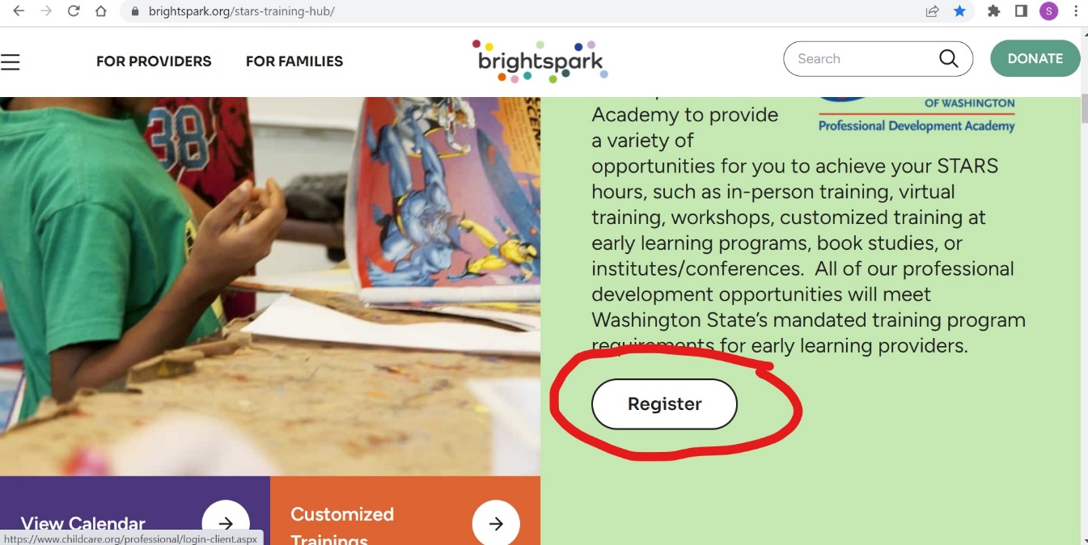
Training Registration
Log into: https://www.brightspark.org/
Navigate to the left side drop down menu- select For Providers- select Professional Development
Now you are on the Professional Development page
Scroll down & click the “register” button
This will take you the registration page: https://www.childcare.org/professional/login-client.aspx
Notes:
A quick re cap how to registration guide will be shared and saved into the S drive

Slide 6
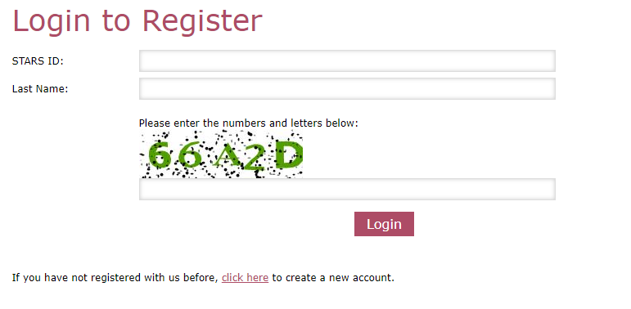
This will take you the registration page:
https://www.childcare.org/professional/login-client.aspx
If this is your first time registering for a class with .
BrightSpark, you will need to create an account first

Slide 7
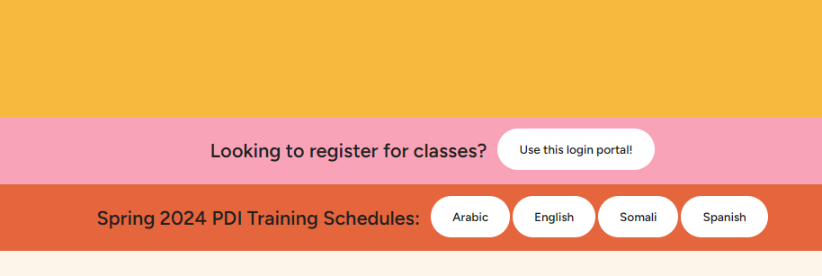
Flyers, Class Descriptions
Click here to begin registration
Click here to see class information

Slide 8
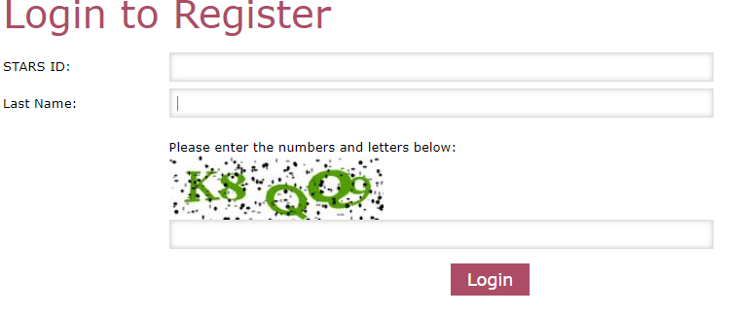
This will take you the registration page:
https://www.childcare.org/professional/login-client.aspx
Not working?
Double check STARS ID and that it doesn’t have a space after the last number.
Did they change last names?
If last name is hyphenated,
Try with and without hyphen.
ex. Penn Gwinn vs Penn-Gwinn
Try a space in between name and hyphen
ex. Penn – Gwinn vs. Penn-Gwinn
You must click “Login” instead of pressing enter in order for this to work

Slide 9
Once you have updated/verified your contact information, click submit.

Slide 10
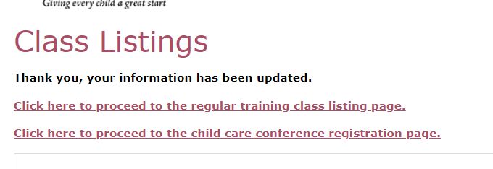
Choose to register for either Virtual or In-Person
Select this link for Virtual PDI classes via Zoom, May 13 - 17
Select this link for In Person on May 18th in Renton, WA
If you would like to attend both, Complete your registration for either the Virtual or In-Person and then return to the log-in page to register for the other.

Slide 11
Virtual Trainings
Trainings occur throughout the day into the evening.
Zoom links are sent the day prior to the trainings
When selecting classes, pay close attention to when each class begins and ends, so that you don’t register for classes that overlap in time
You may want to have the following available: Paper, Pen, Water, Snack, fidgets such as playdough, manipulatives, etc.
Make note on your own calendar what time each class begins.
Refunds must be requested 7 calendar days prior to a training. Refunds are not granted for late arrivals, missed classes, or leaving a class early.

Slide 12
In-Person Trainings
Completing your Registration $30 till April 29th
Everyone check “Child Care Conference.” This ensures everyone receives meals
Select ONE Morning class
Select ONE Afternoon class
Proceed to payment details

Slide 13
In-Person Trainings
Only registered individuals will be admitted. We are unable to accommodate extra people including children.
We do not have control of the temperature in the rooms, please dress in layers.
Please bring with you a Water bottle, pen, notebook
Refunds must be requested 7 calendar days prior to a training. Refunds are not granted for late arrivals, missed classes, or leaving a class early.

Slide 14
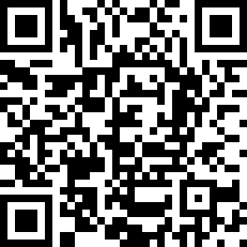
Requesting Interpretation
Some classes will be offered in Arabic, Somali and Spanish.
For any classes taught in English, you may request an interpreter by May 6th.
Register for the class(es)
Complete this form via this link or QR code: https://forms.monday.com/forms/cab16fcf8ac310146d954b49978524e2?r=use1

Slide 16
Remember to add dates and times to your calendar,
See You in May!

Slide 17
Professional Development Institute May 13 – 18, 2024
Write down the times and names of your classes.
Zoom links are sent the day before
Monday | Tuesday | Wednesday | Thursday | Friday
May 13 | May 14 | May 15 | May 16 | May 17
Friday
May 18
Must register separately. Before April 26th

Slide 18
Attendance
To receive credit for the training, you must attend and participate throughout the training.
You must remain on the call for the duration of the training to receive credit.
Please stay engaged in the training. Participation is required.
Attendance will be taken at the end of the session.
Notes:
TAKE ATTENDANCE: FIRST, LAST NAME, STARS ID, EMAIL
Please change your name to reflect your actual name (so we can give you the credit)
HOLD FOR PAUSE

Slide 19
Participation
Engagement and participation in the training is required
You can participate through
Chat Box
Polls
Discussions
Breakout Rooms (small group discussions) You will be asked to join breakout rooms. This is a requirement of the training.
Notes:
Engagement: chat/ raising hand/ break out rooms/ asking questions
We will designate time at the end for questions as well

Slide 20
Choosing Interpretation Channel
Click on Interpretation
Choose language – You should be in audio channel with the interpreter.
After each breakout you will need to repeat these steps.
Haga clic en el botón de interpretación.
Escoja un idioma, usted entrará en el canal de audio con el interprete.
Recuerde que después de cada actividad en grupo pequeño, al regresar a la sala principal, usted necesitará repetir estos pasos.
Click on Interpretation
Choose language – You should be in audio channel with the interpreter.
After each breakout you will need to repeat these steps.

